Slide 1
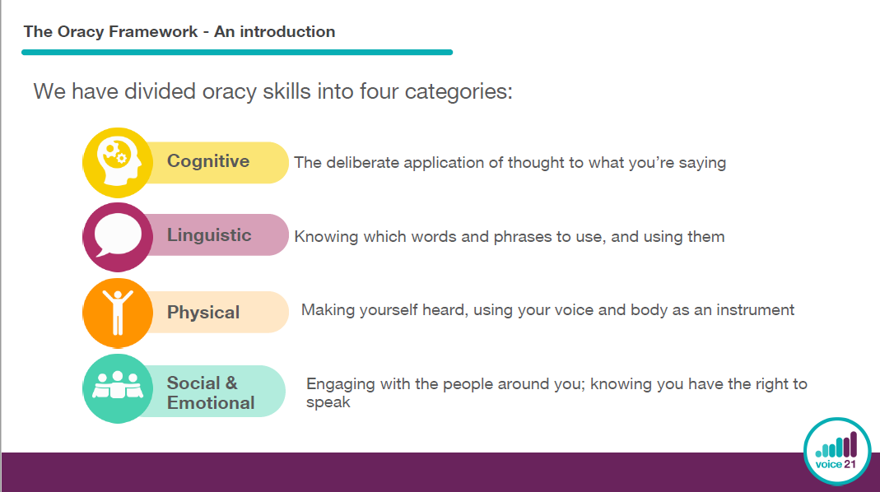
Notes:
The framework pins down what we mean by oracy and divides oracy into four strands. The cognitive which is about the kind of thinking that underlies what it is your saying; your content, your reasoning, how you structure that, the questions that you ask. The Linguistic which is about your use of language, and judging what is appropriate for different contexts and choosing language for effect. The physical which is how you use your gestures, your body language, how you use your voice, including volume The social and emotional which in a group situation might be about working with others, taking it in turns, listening to other people. In a presentational situation it might be the impact that you want to have on the audience and your impact as a speaker. All of the strands outlines all of the oracy skills that children need to develop to become strong speakers and listeners.

Slide 2
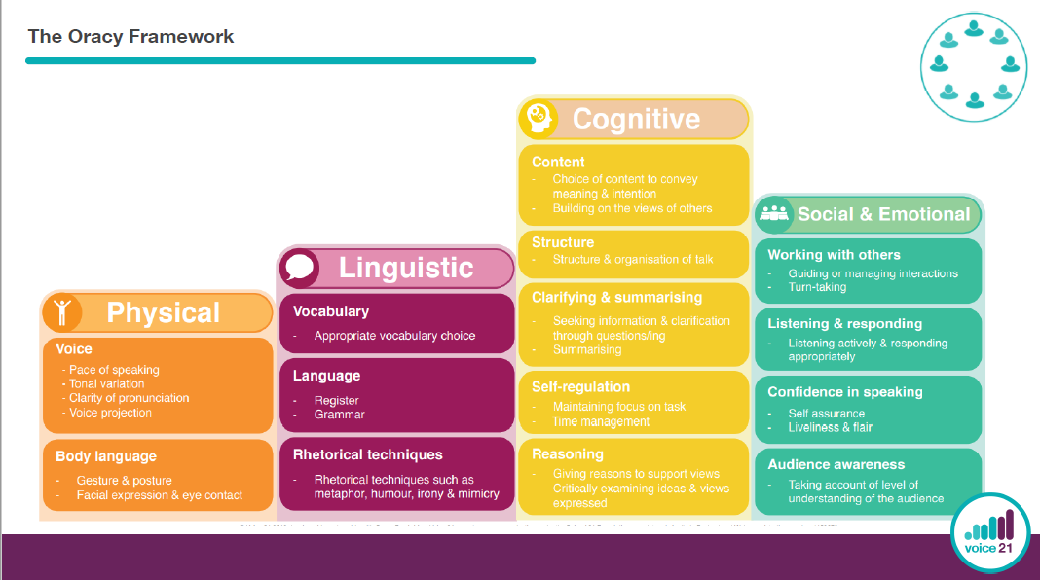
Notes:
These strands are broken down further to help us hone in on what we are really looking for in each strand of the framework allowing us to identify what children have achieved and our next steps.
These are things we need to teach the children, so depending on the context children may have different pace of speaking or a different tone of voice.
The expectation of what this looks like varies from year group, to year group as the children learn the different skills of oracy and make progress in their talk.

Slide 3
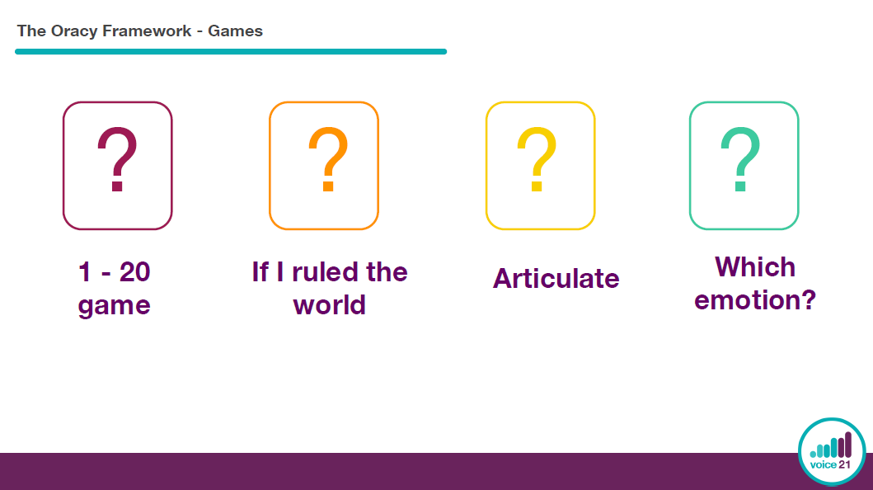
Notes:
We are going to demonstrate 4 different games which will help to highlight the importance of the different strands of the framework.

Slide 4
We are going to count to 20, one person saying one number at a time.
Anybody can start the count.
Then a different person says the next number.
But if 2 or more people happen to speak at the same time, counting must start again from the beginning.
Notes:
This is one of the simplest, yet most challenging games. Sit or stand in a circle. The idea is for the group to count to twenty, one person saying one number at a time. Anybody can start the count. Then a different person says the next number – but if two or more people happen to speak at the same time, counting must start again from the beginning. It is possible to get to twenty if everybody really concentrates – but try and be relaxed as well.

Slide 5
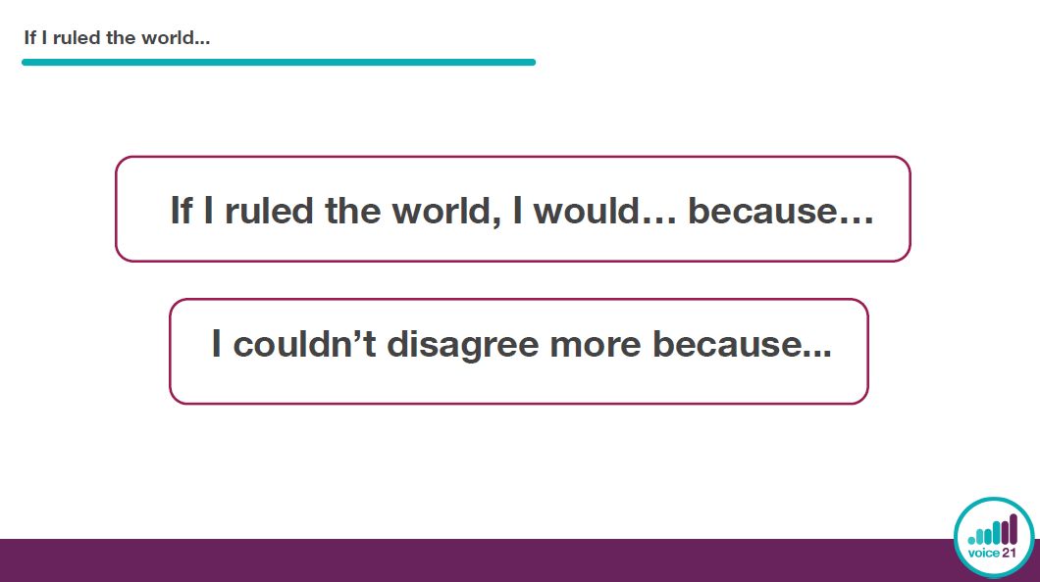

Slide 6
Think of a word of an item/object.
You must describe the item/ object without saying the word of what it is.

Slide 7
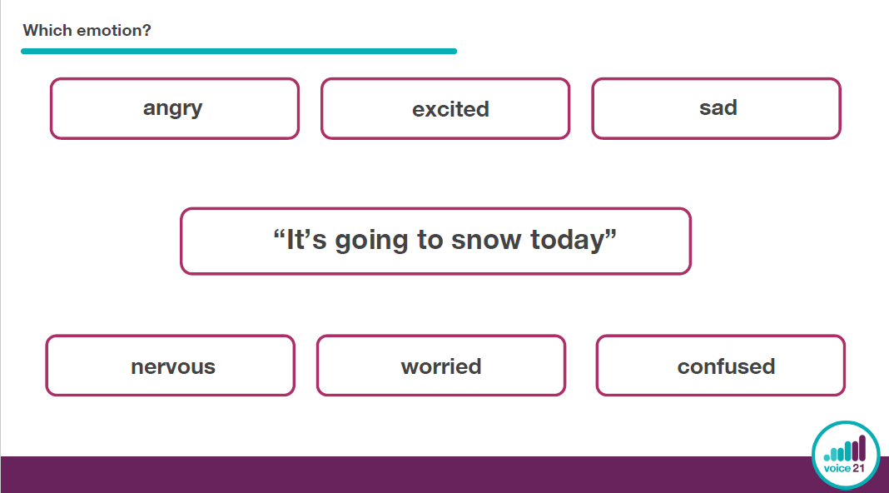

Slide 8
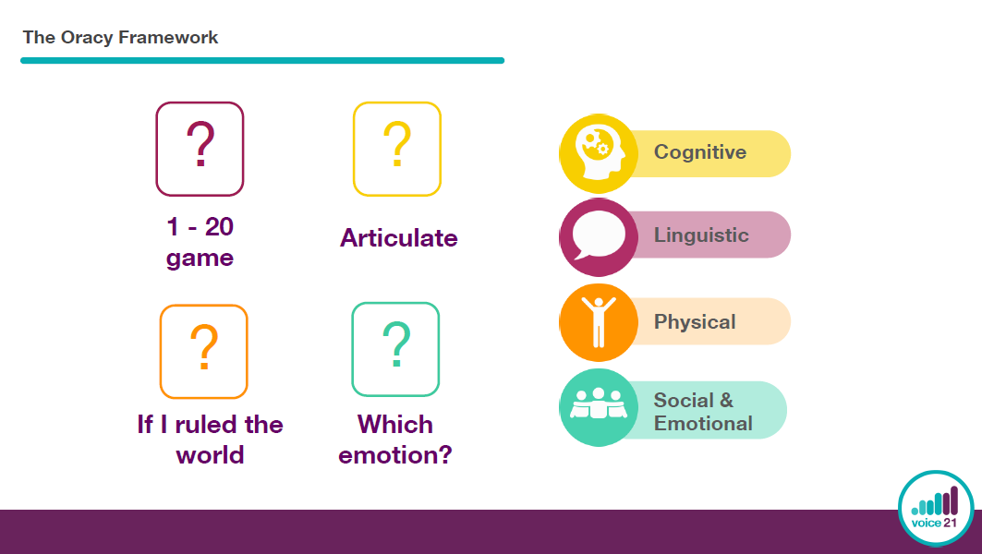
Notes:
Which game do you think related to which strand?
1-20 social and emotional- listening and responding, working with others
If I ruled the world- cognitive- structure, building on the views of others, giving reasons to support views
Articulate-Linguistic- appropriate vocab choices
Which emotion?- Physical- facial expression, tonal variation, gesture and posture, etc.

Slide 9
Scaffolds we use
Groupings
Roles
Sentence stems and talk tactics
Listening strategies
Notes:
There are certain scaffolds we use to help facilitate talk, all of these are strategies that aim to encourage children to feel comfortable and confident in sharing their ideas but also to feel that they are able to have their own opinions and challenge the ideas of others respectfully. We also want children to feel comfortable in having their ideas challenged so we aim to make the discussion environment one in which all children feel valued and respected.
Our role is to equip the children with everything they need to be able to have successful talk in a variety of contexts and settings.

Slide 10
Groupings
Year 1
Year 2
Year 3
Year 4
(Nest)
(Pair)
Trio
(Nest)
(Pair)
(Trio)
Traverse
(Nest)
(Pair)
(Trio)
(Traverse)
Fish Bowl
Small group discussions
(Nest)
(Pair)
(Trio)
(Traverse)
(Fish Bowl)
(Small group discussions)
Circle
Notes:
Nest- whisper ideas to yourself
Pair- talk to one other person
Trio- 3 people stand together, while 2 talk, the third person either joins in or listens in and summarises or critiques the discussion
Traverse- stand in 2 parallel lines opposite a partner, change partners by moving one person down the other end of the line
Fish bowl-people in the inner circle face each other and discuss while outer circle observes the discussion
Small groups- 4 or 5 discuss with different roles.
Circle-groups of 6 or more sit facing each other in a circle. You can step inside the circle one at a time to speak to the whole group

Slide 11
Roles
My turn, your turn
Speaker, Listener
Back and forth
2 talk, 1 observe & share
Class research groups & Feedback
Talk for a specific purpose

Slide 12
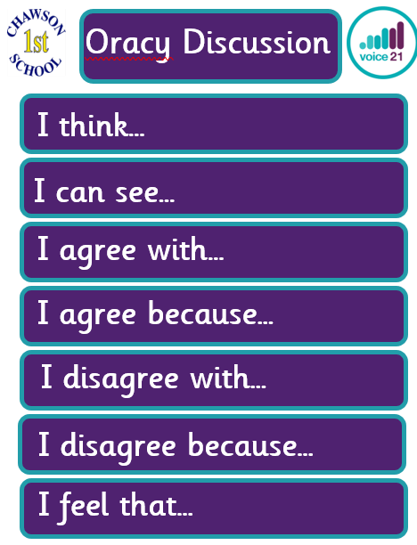
Sentence stems
Notes:
First 5 in Y1
All in Y2
All in Y3 and 4 but they have some talk tactics too.
Sentence starters for how children can begin sharing their thoughts with the class. I agree and disagree give opportunities to respectfully challenge other ideas.
Teachers may prompt children on which sentence stems they would like them to use in a lesson or may leave it open to the child’s choice.

Slide 13
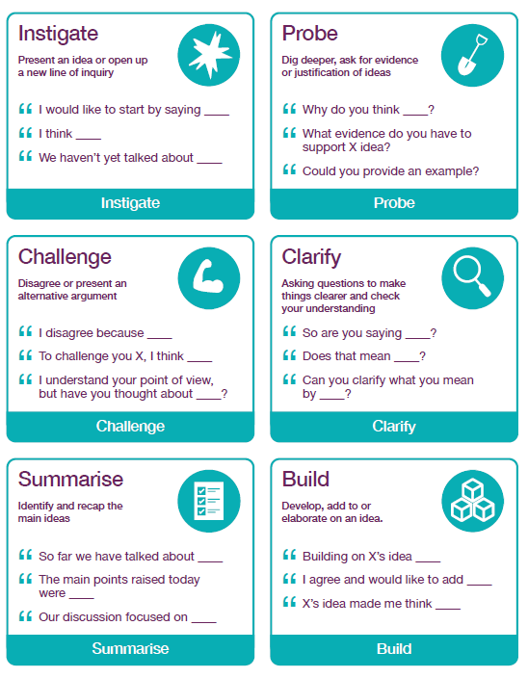
Talk Tactics
Notes:
Y3- instigate and summarise
Y4 all

Slide 14
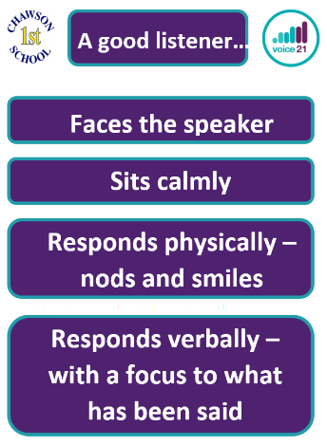
Listening strategies
Notes:
Every classroom has on display our expectations of what good listening looks like. We as adults, model this so that the children can see what good listening looks like and know that we are actively engaged in conversation with them. We expect all of our children to show that they are a good listener during class discussions so that every person can feel their contributions are valued and respected and to maintain quality discussions.

