Slide 1
Oracy in Early Years

Slide 2
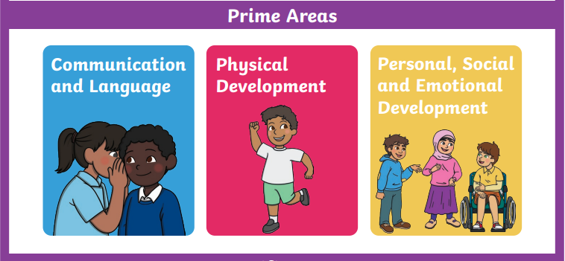
Voice 21 in the Early Years

Slide 3
While no one would ever question the need to teach a child to read, all too often it is assumed that speaking is a skill that doesn’t require teaching – instead, children should just “pick it up.”
But not all children will.
Gaunt and Stott 2019

Slide 4
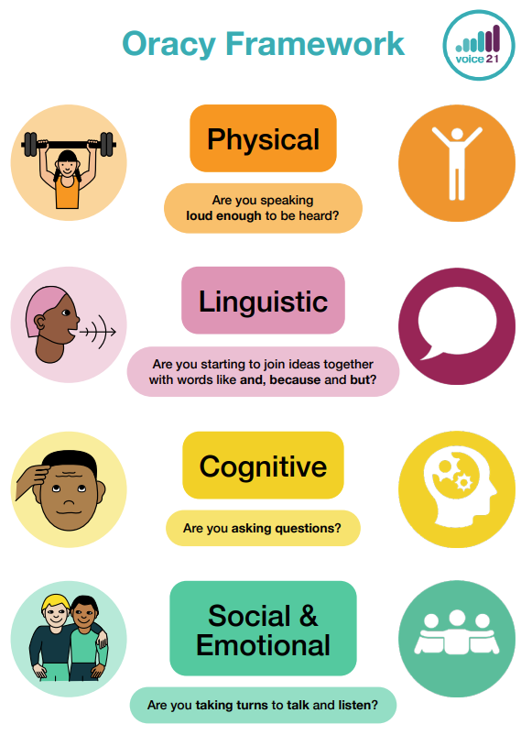

Slide 6
To speak well children must first learn to listen well
Gaunt & Stott 2019

Slide 7
What do you think good listening looks like?

Slide 8
Listening - Physical
Facing the speaker
Making eye contact
Remaining calm and still – not distracting the speaker

Slide 9
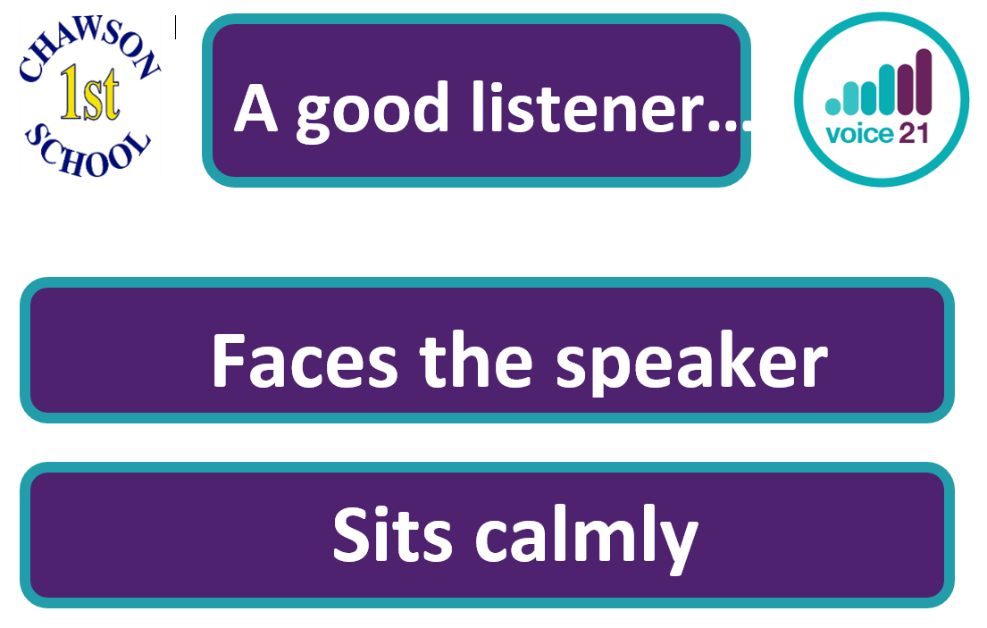
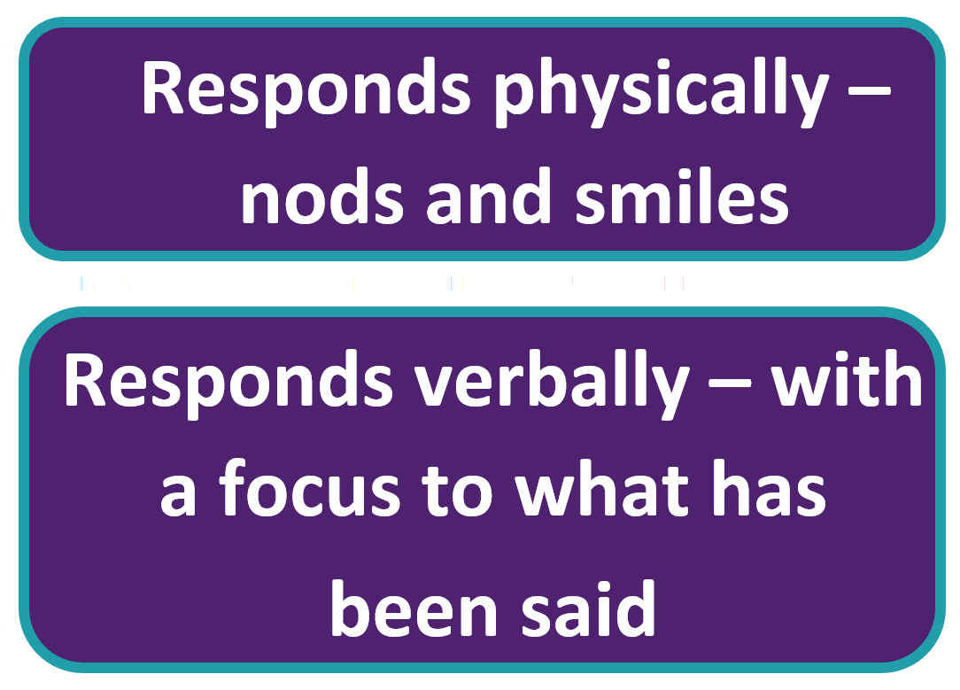

Slide 10
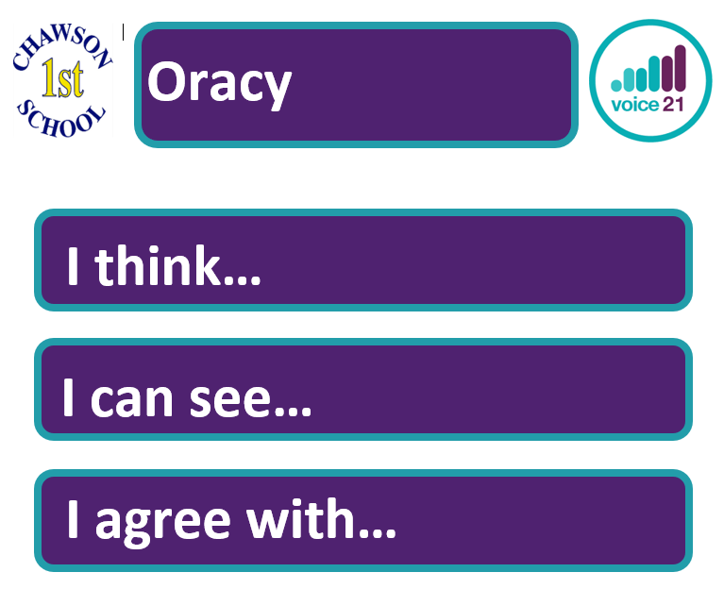
How we teach Oracy in reception
Grouping – nest and partners
Sentence stems

Slide 11
Communication and Language -
In action
Social phrases
Story time
Learning rhymes, poems and songs

Slide 12
Talk for Ten

